Slide 1
Project on Islamic Resources
Submitted To:
Kazi Wohiduzzaman
Senior Lecturer, Dept. Of EEE
Metropolitan University
Submitted By:
Md Rubel Siddek
ID: 141-115-016
Date:16th August,2017

Slide 2
Index:
Home Page
Registration
Login
Image
Audio
Video
Contact

Slide 3
Objective:
People can easily find Al-Quran Sura, Islamic video, Islamic audio, Islamic image.
Good user interface.

Slide 4
Description :
Login and register facilities for user.
Guest user can only show image , audio, video.
Registered users can add, delete, and update the image, audio and video.
Every user can download image, audio and video.
Users can contact with the admin of the website through contact form.
All user is control by admin.

Slide 5
Flow chart:
Home
Image
Audio
Video
Signup
Contact
Login
Upload Image
Upload video
Upload audio
Logout

Slide 6
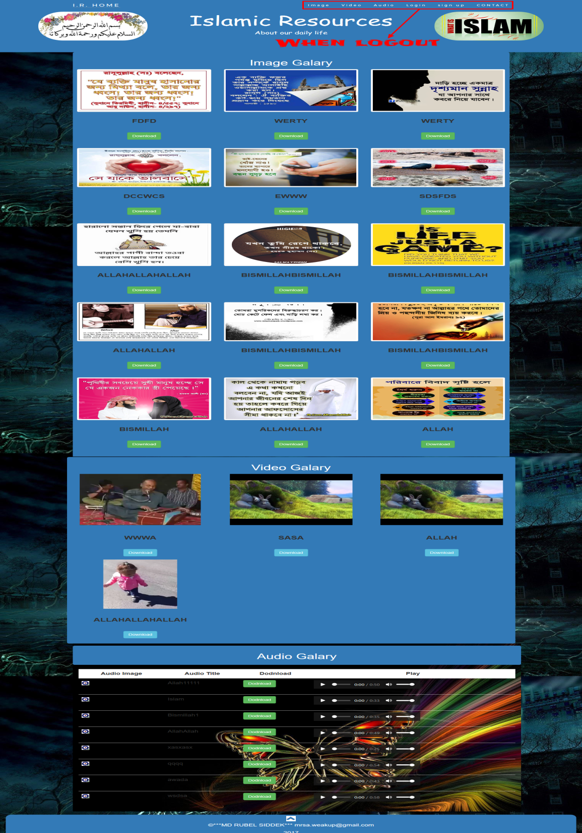
Home page:
When logout.

Slide 7

Home page:
When login.

Slide 8
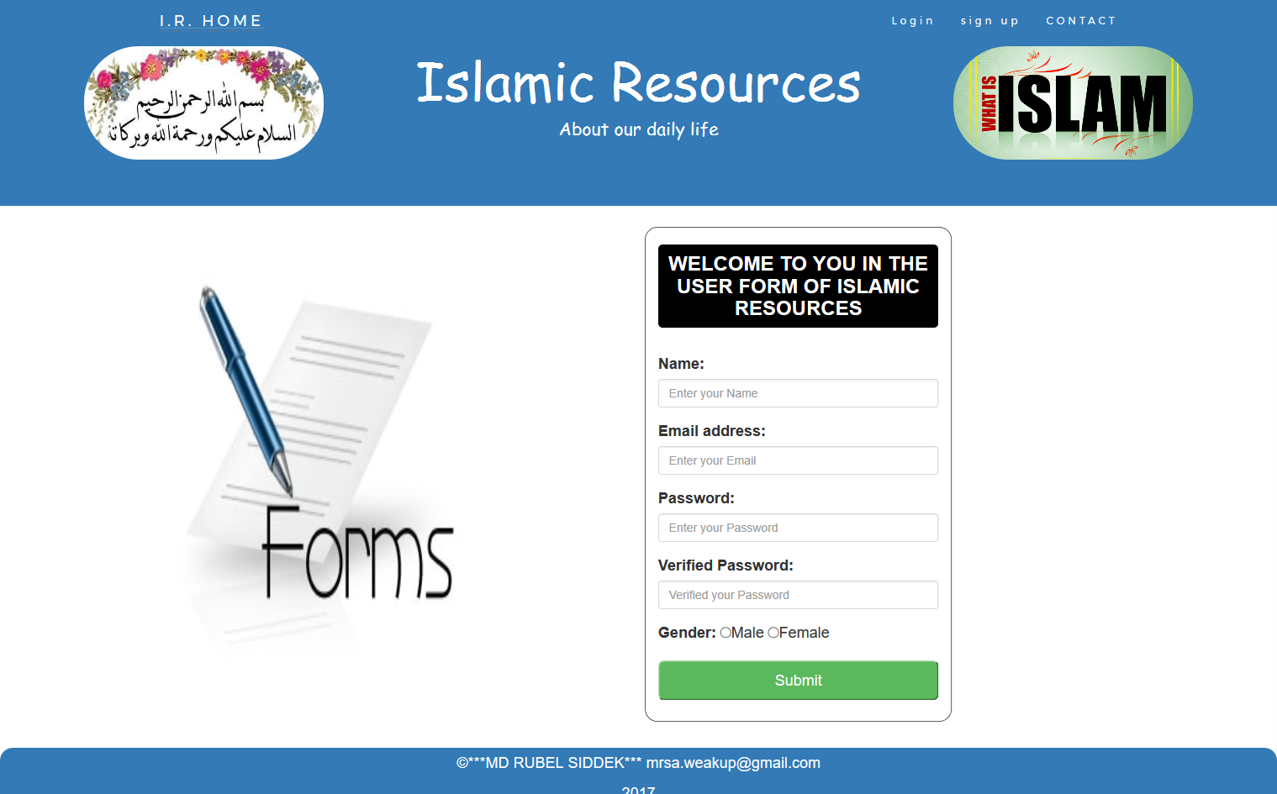
Registration page

Slide 9
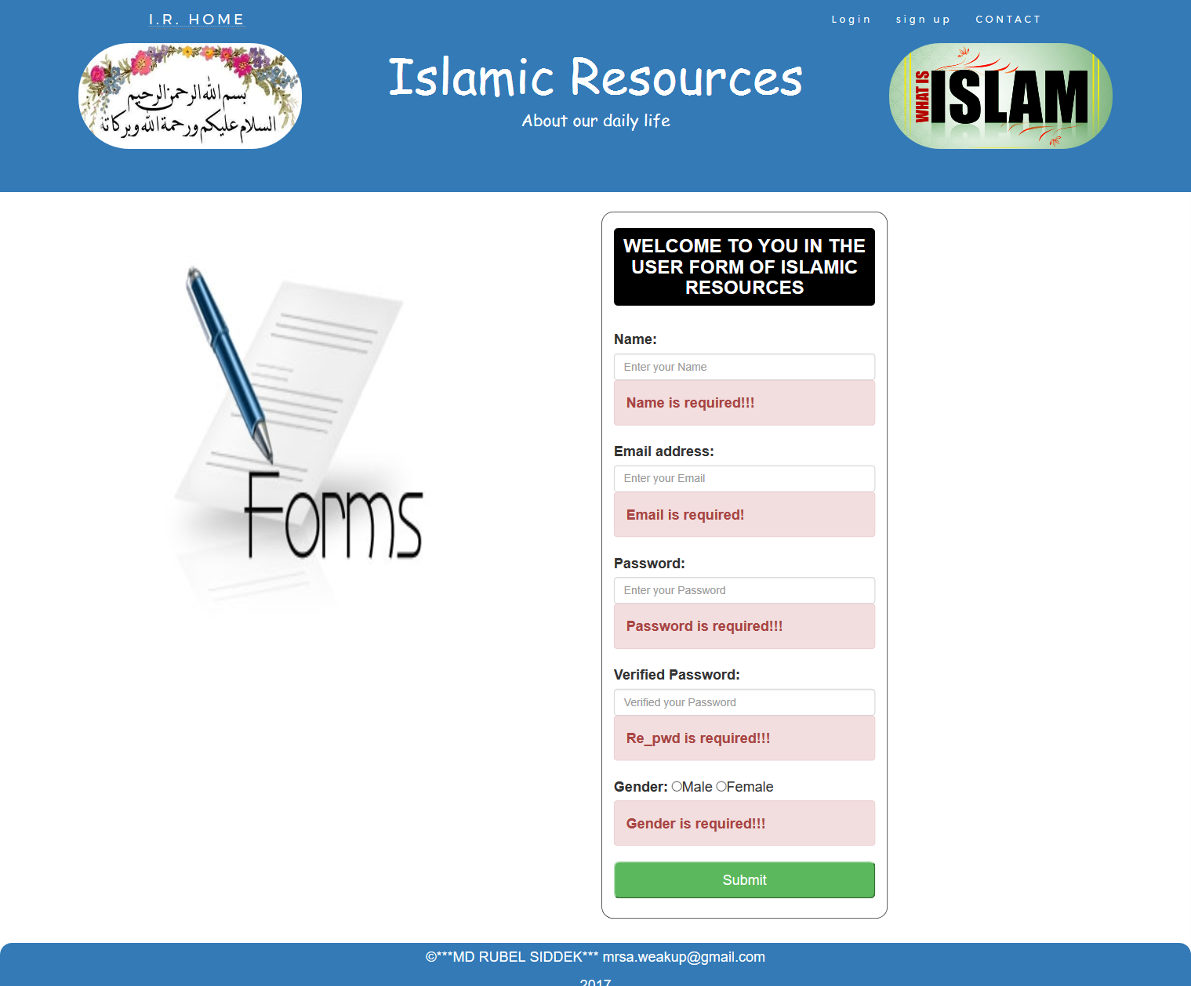
Registration page
with validation

Slide 10
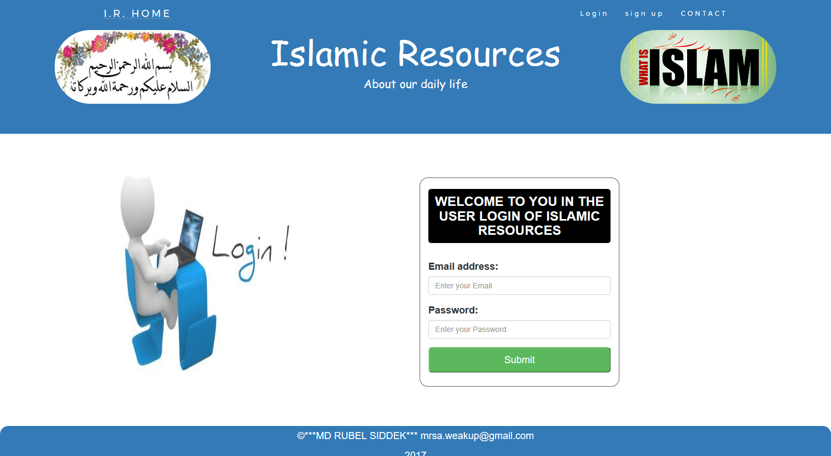
Login page

Slide 11
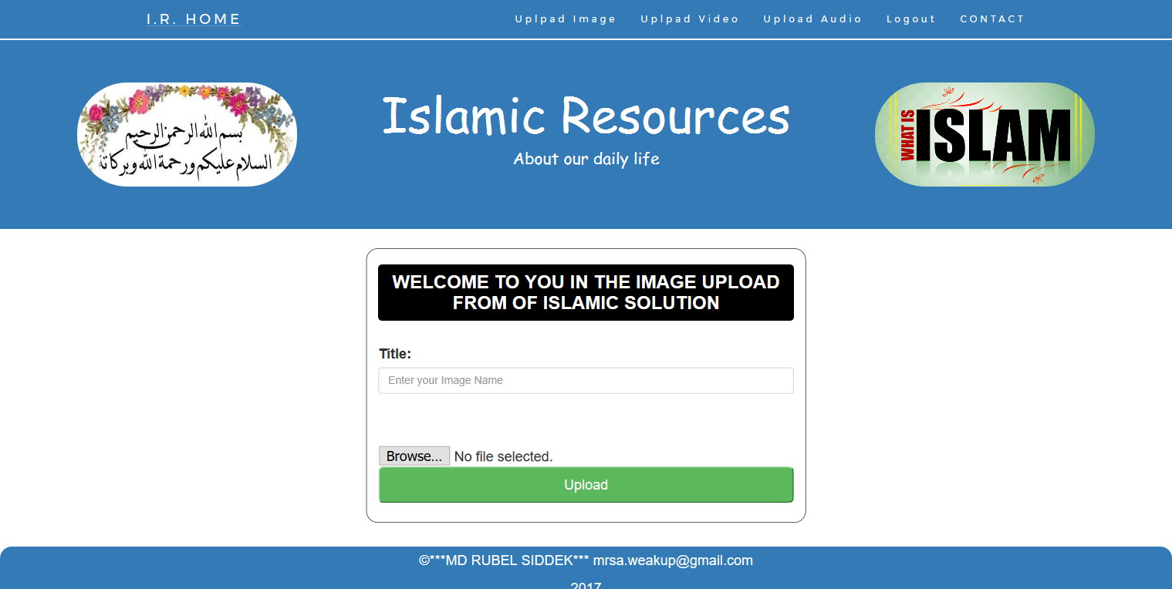
Image upload

Slide 12
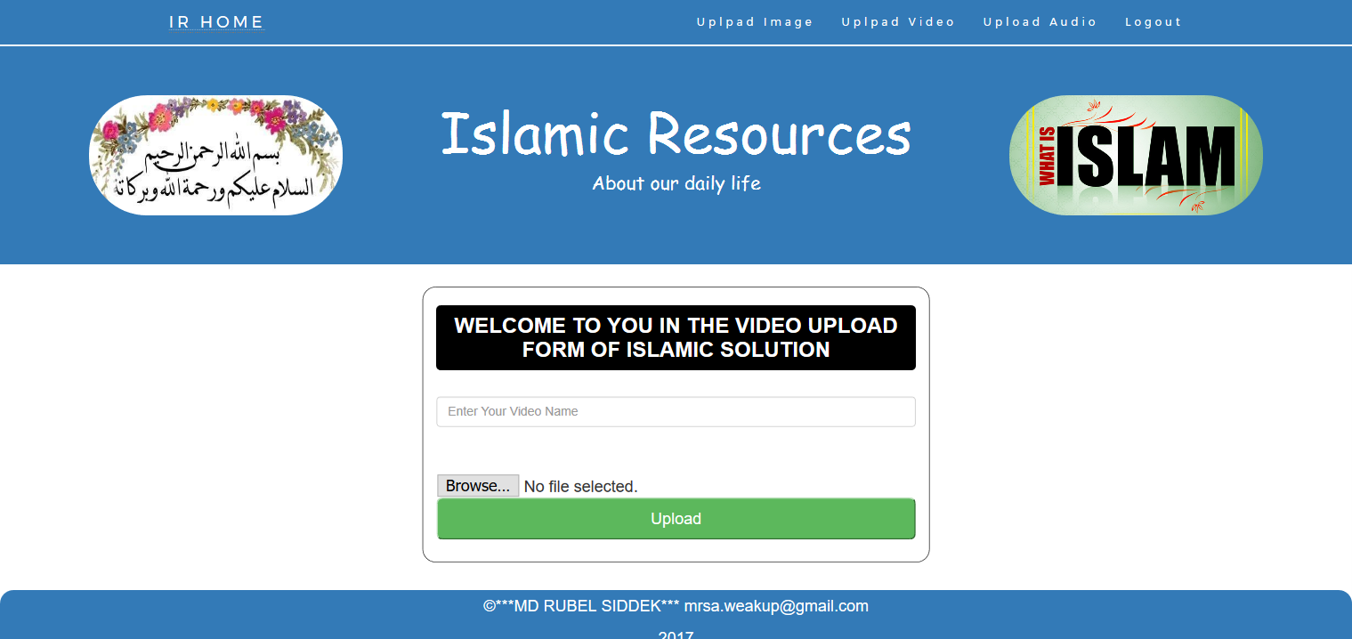
Video upload

Slide 13
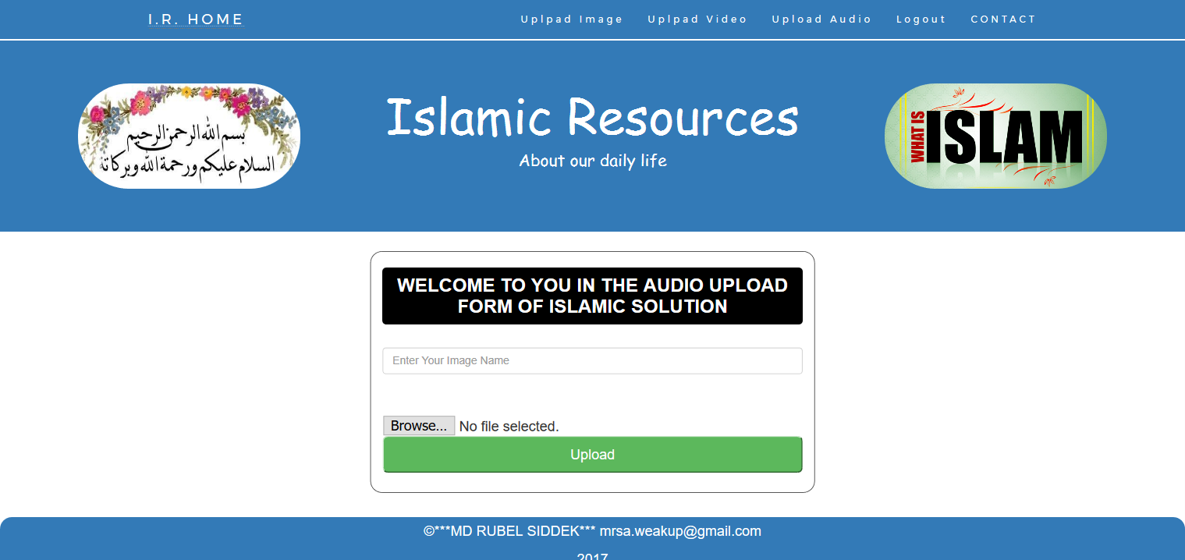
Audio upload

Slide 14
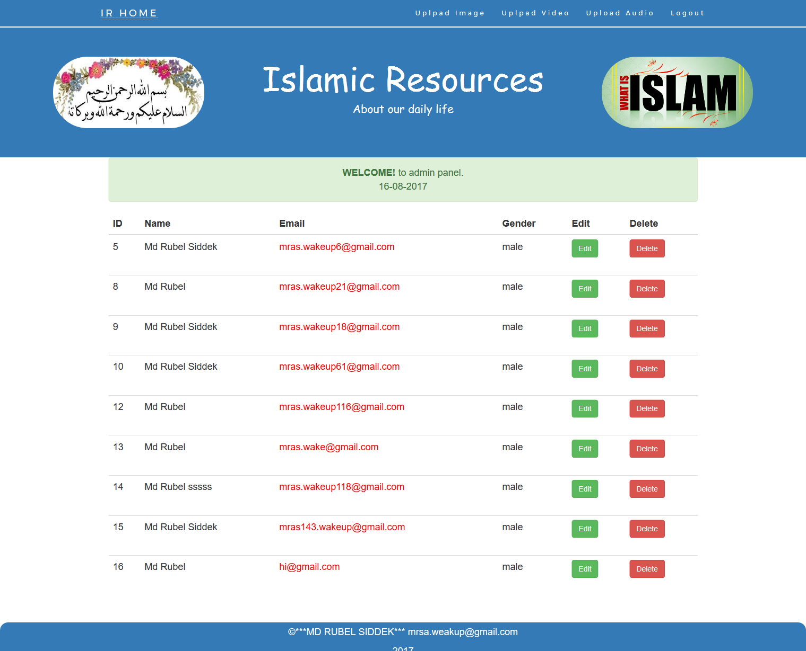
Admin panel

Slide 15
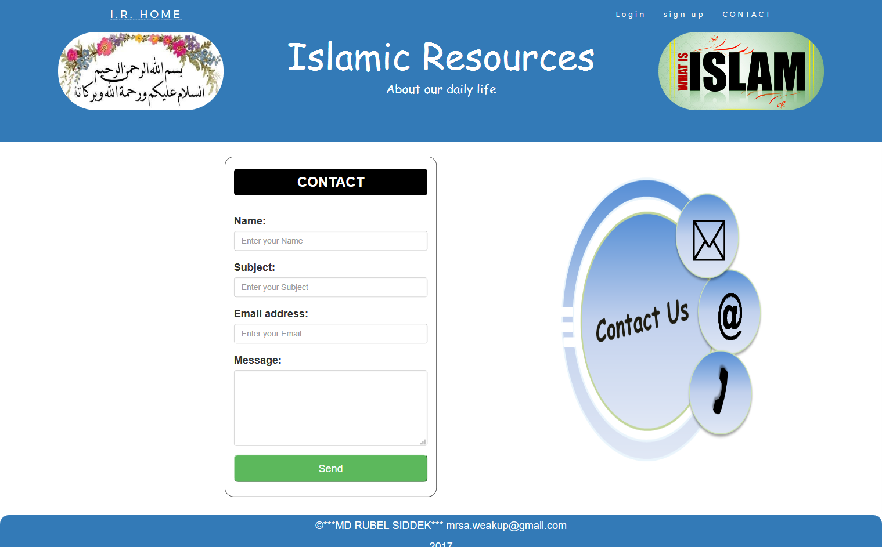
Contact page

Slide 16
Development tools:
PHP
Mysql
HTML5
Bootstrap
CSS
jQuery

Slide 17
Thank you

